Slide 1

Risk Radar :
Forecasting Credit Card Default
Ting Siou Chen
20241209 Risk Radar : Forecasting Credit Card Default

Slide 2
Motivation & Goal
Flowchart
Exploratory Data Analysis (EDA)
Result
IDA Template

Slide 3
Motivation
Motivation
Risk management and loss prevention
Efficient resource allocation
Customer segmentation and tailored services
Goal
Develop a predictive model
Accurately identifies customers with a high risk of default
Allowing financial institutions to minimize losses and optimize credit strategies.
IDA Template
Notes:
As we know, credit is important in our lives. In banks, it is also crucial for their operations. They need to manage the risks posed by their customers—meaning you, me, and anyone who borrows money from banks. If they don't evaluate these risks, the bank may face financial problems. On the other hand, proper risk evaluation allows banks to maximize profits by efficiently allocating resources. By assessing customers’ credit, banks can segment their customers and offer tailored services. Therefore, I aim to develop a predictive model that accurately identifies customers with high risk. This will enable banks to minimize losses and optimize the allocation of funds.

Slide 4
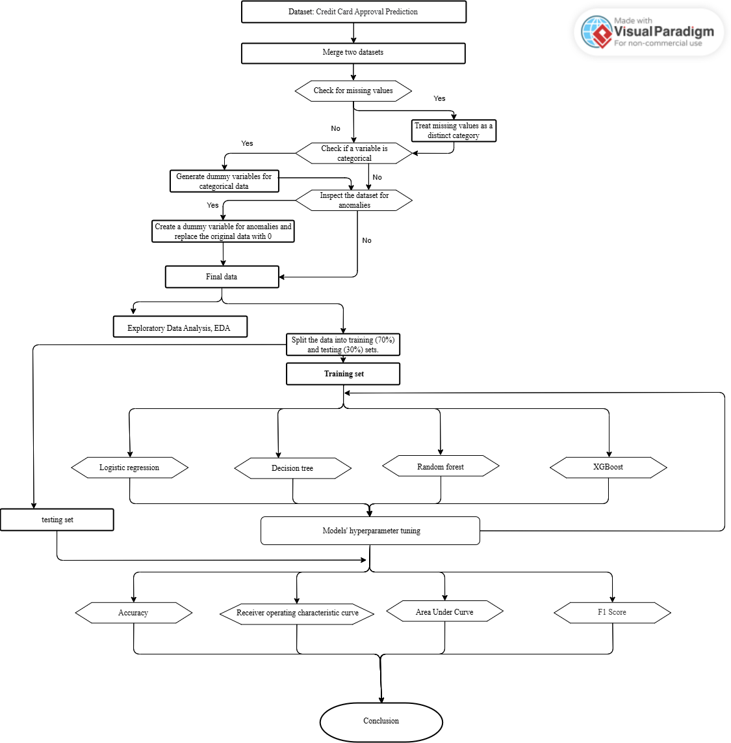
Section Title
Flowchart
Title

Slide 5
Section Title
Flowchart
Title

Slide 6
EDA
EDA-data
Dataset
Contains demographic and credit behavior data from credit
card applicants, divided into : application_record.csv,
credit_record.csv
Source
Kaggle - Credit Card Approval Prediction Dataset
IDA Template

Slide 7
EDA
EDA-data
Sample Size (n): 36457
Number of Features (p): 41 features
Data Categories
Demographics, Financial status, Past credit behaviors
IDA Template

Slide 8
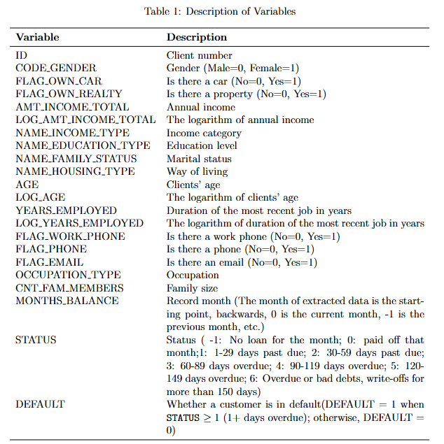
EDA
EDA-data
IDA Template

Slide 9
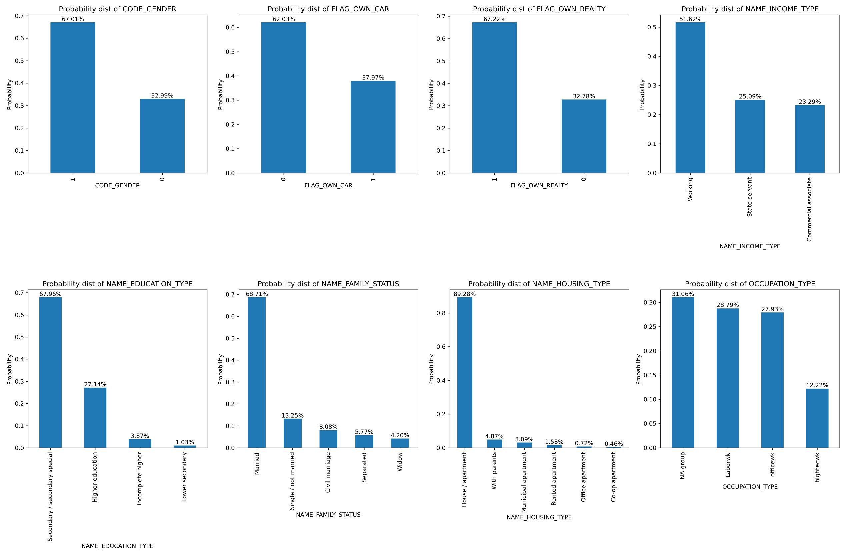
EDA
EDA
Categorical variable
IDA Template

Slide 10

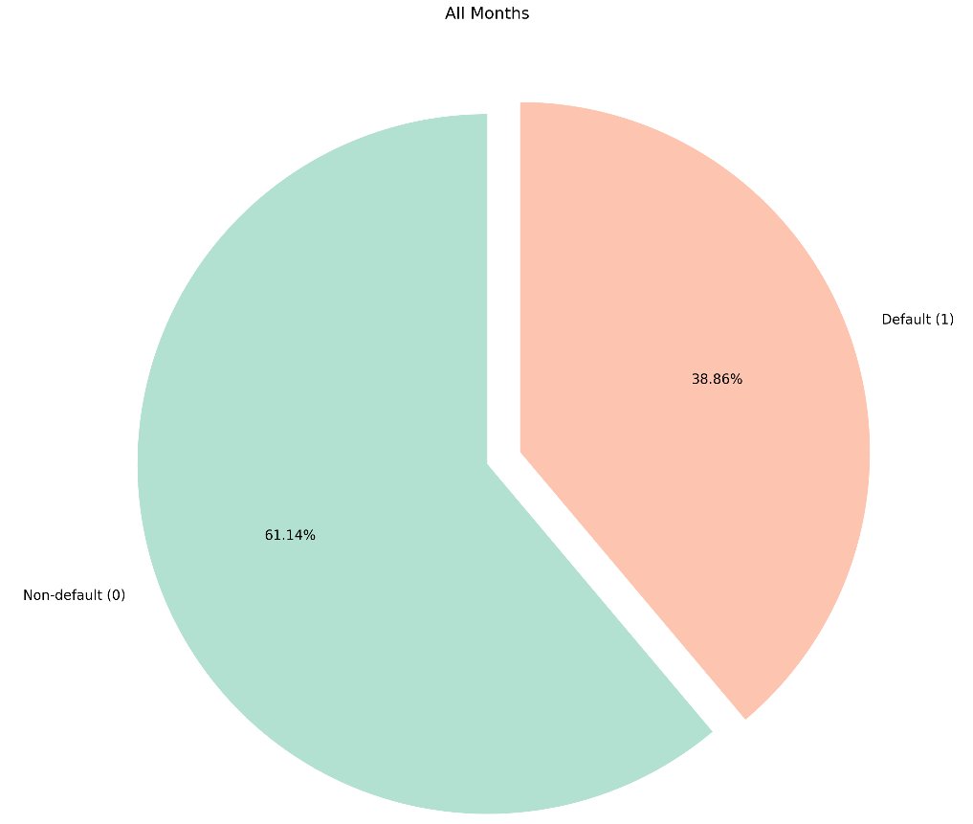
EDA
EDA
Categorical variable
IDA Template

Slide 11
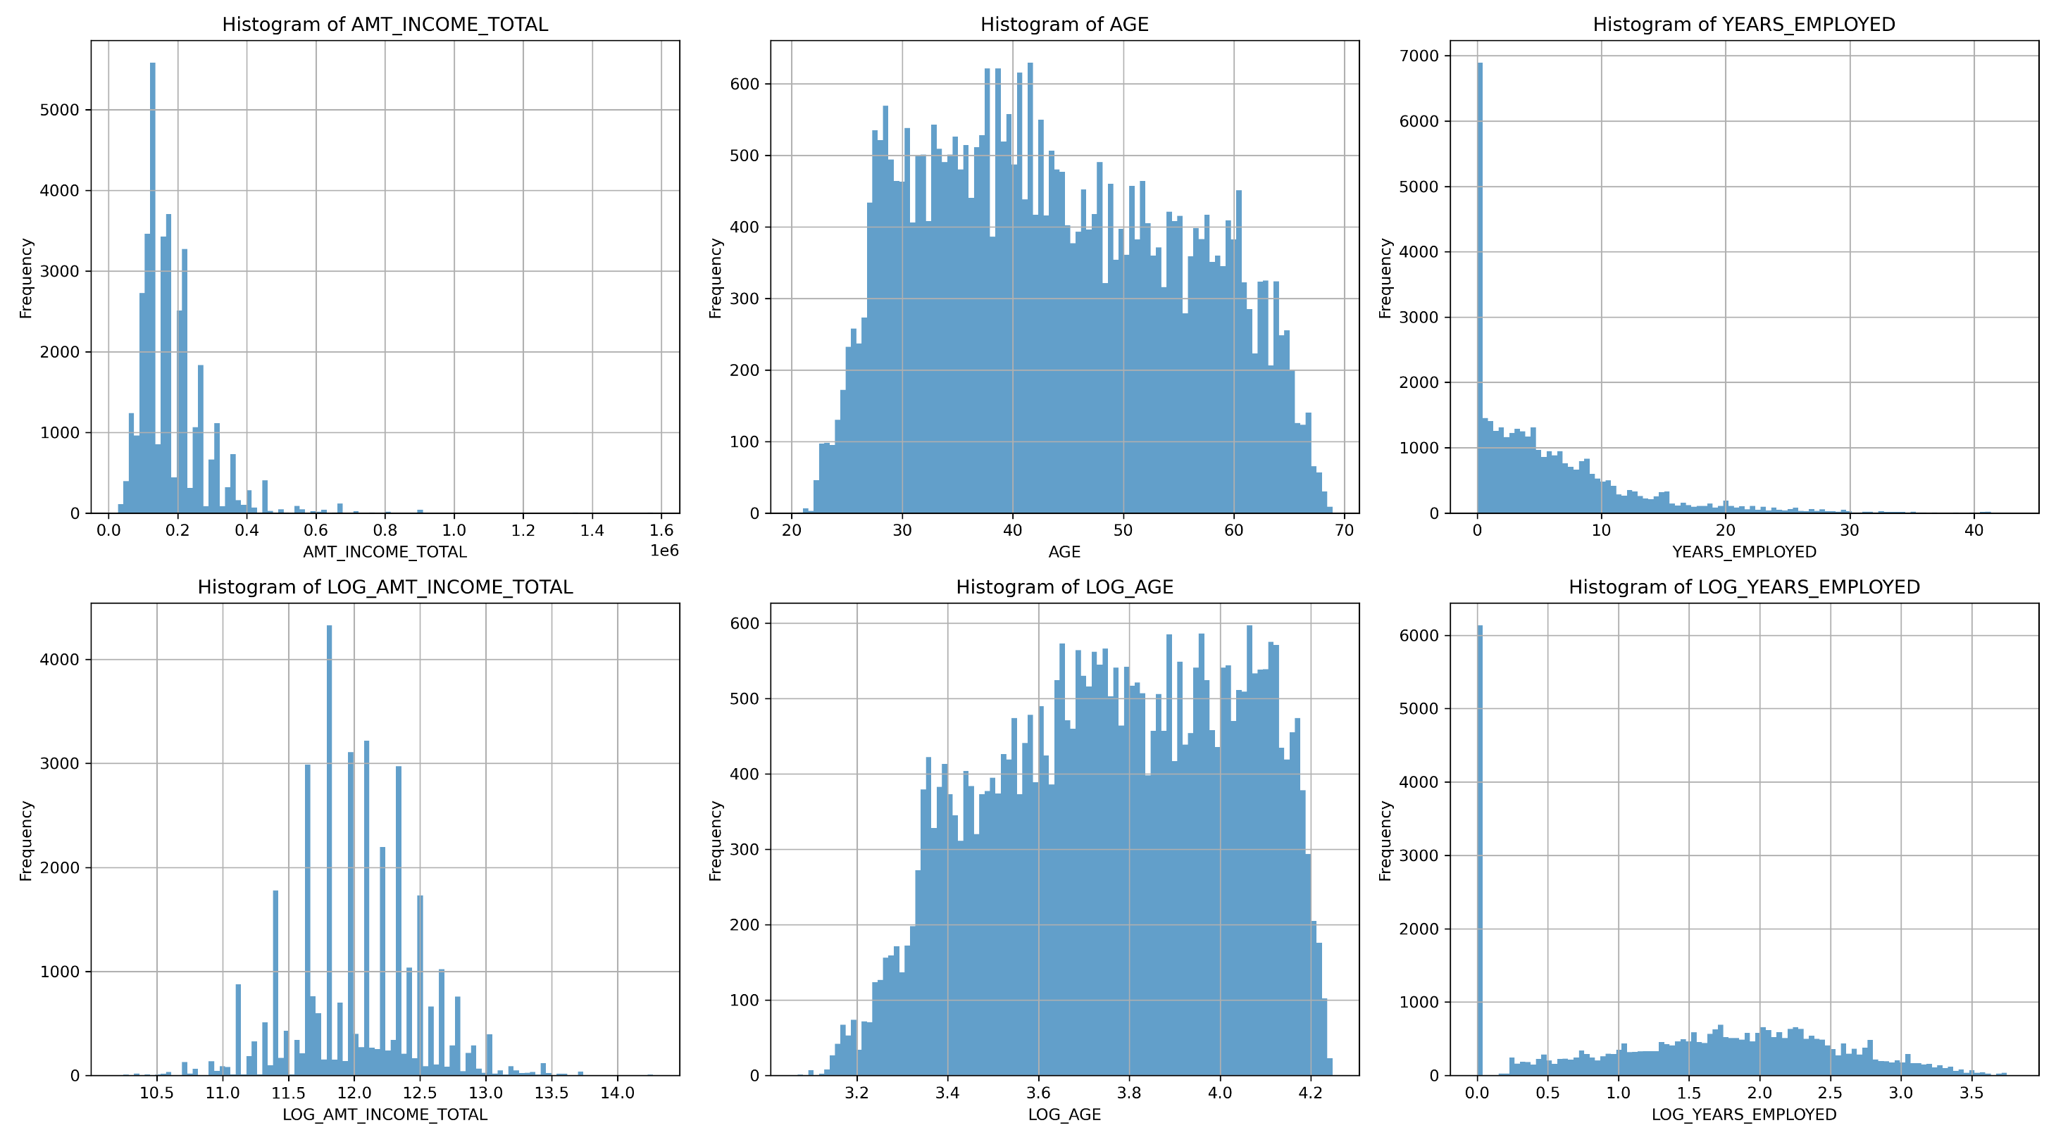
EDA
EDA
Continuous variable
IDA Template

Slide 12
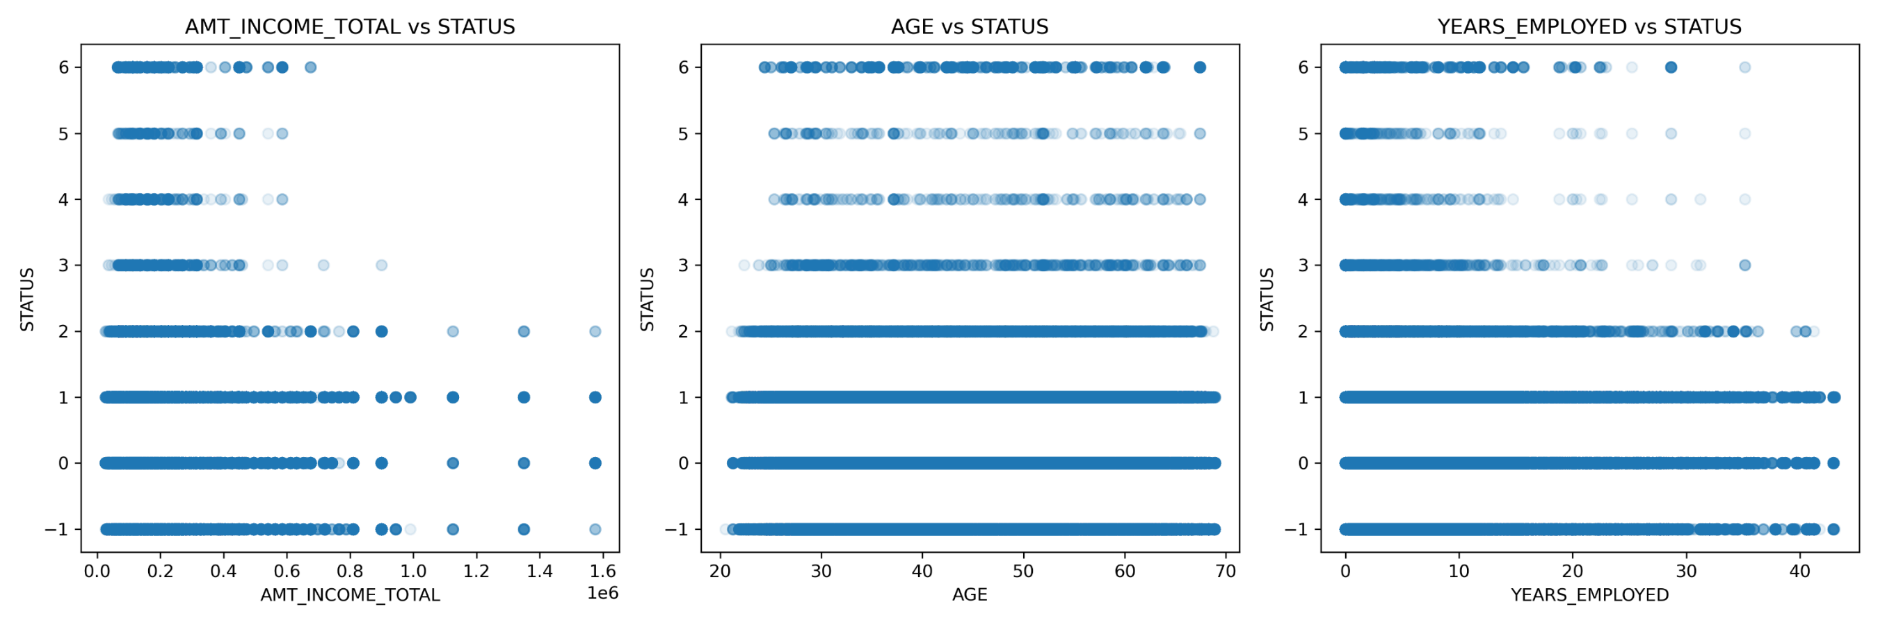
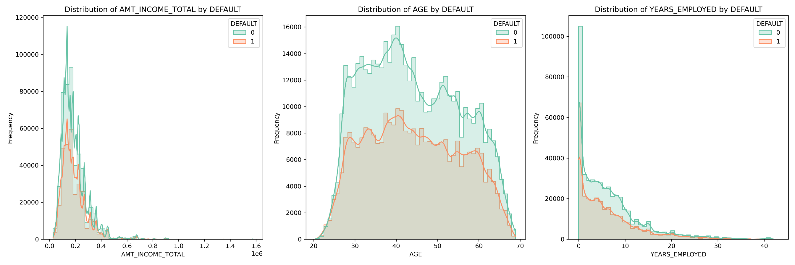
EDA
EDA
STATUS/DEFAULT v.s. continuous variables.
IDA Template

Slide 13
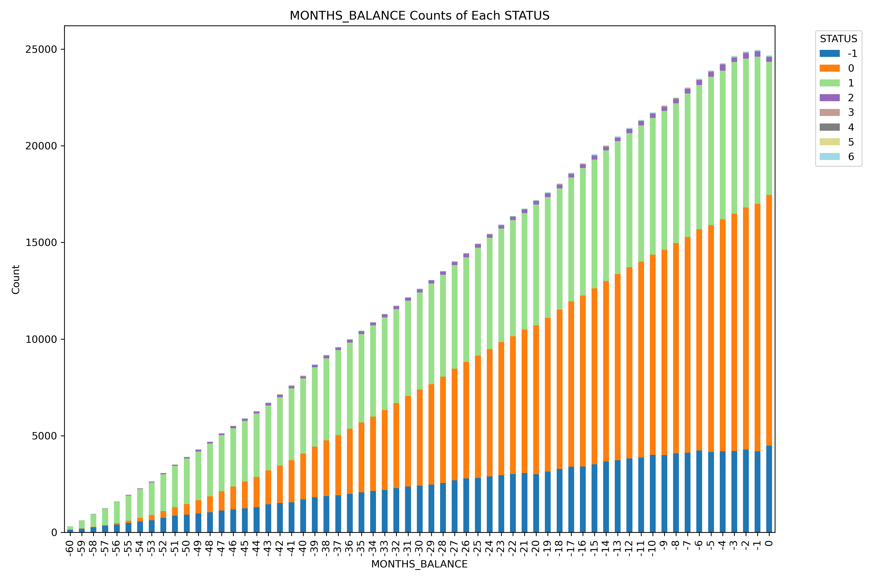
EDA
EDA
Stacked Bar Chart of STATUS by MONTHS BALANCE
IDA Template

Slide 14
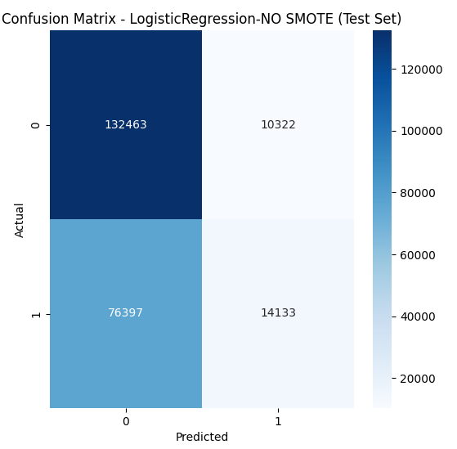
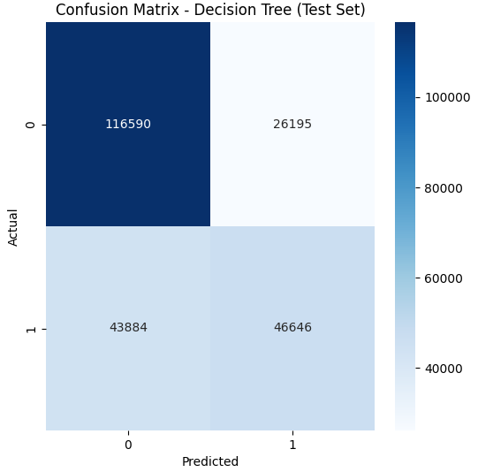
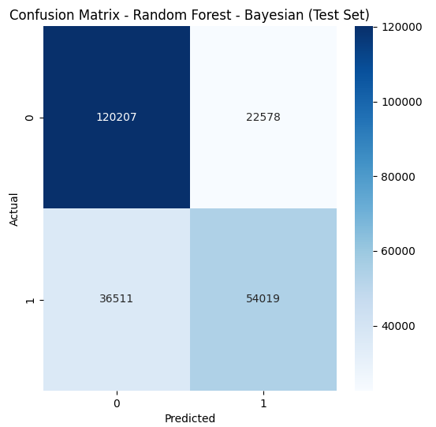
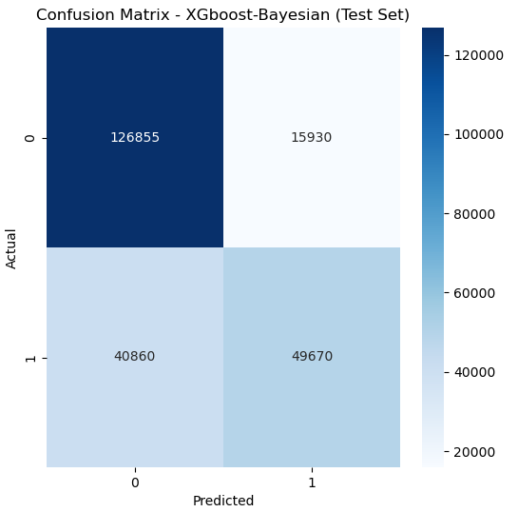
EDA
Result - Confusion matrix
Logistic regression
Decision tree
Random forest
XGBoost
IDA Template

Slide 15
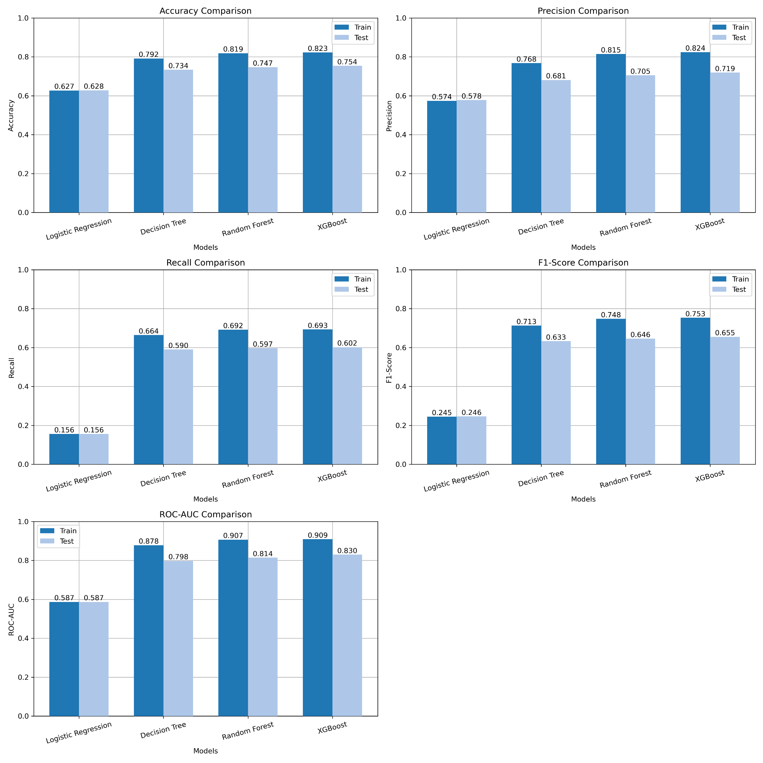
EDA
Result - Accuracy
IDA Template

Slide 16

EDA
Result – Precision , Recall
IDA Template

Slide 17
EDA
Result – F1 score
IDA Template

Slide 18
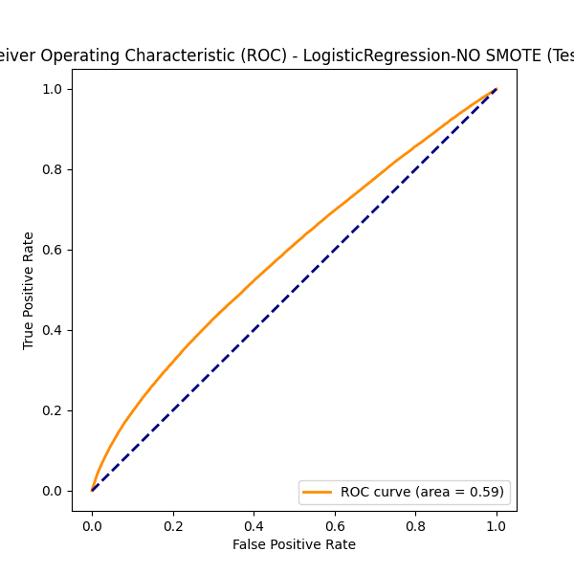
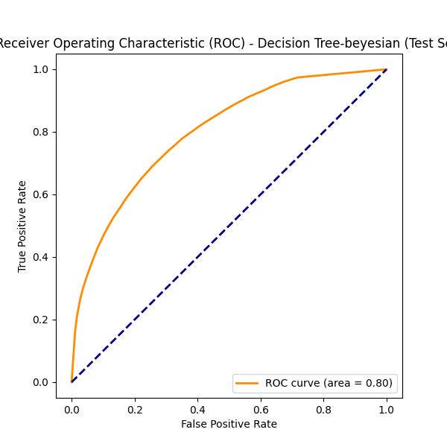

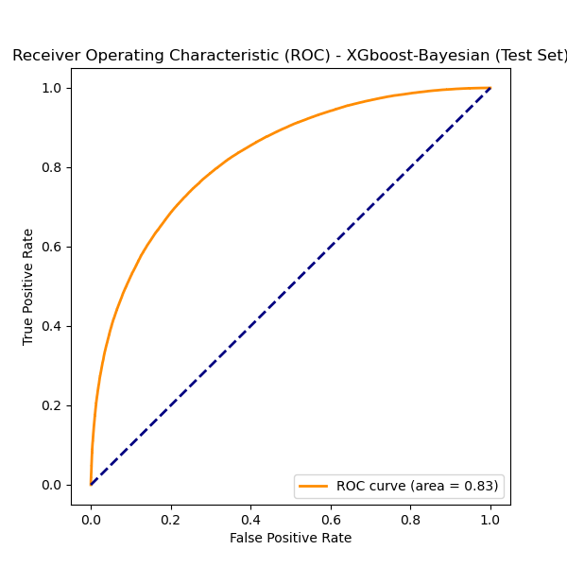
EDA
Result – ROC, AUC
Logistic regression
Decision tree
Random forest
XGBoost
IDA Template

Slide 19
Risk Radar :
Forecasting Credit Card Default
Ting Siou Chen
20241209 Risk Radar : Forecasting Credit Card Default

